Slide 1
Welcome to Python I
TAs - Shalini Kunapuli and Pooja Doctor
LAs - Katharine Chua, Ricky Pan, Eric Gan

Slide 2
Check in to the workshop! Fill out this form:
http://bit.ly/2wNiJIA

Slide 3
Setting up Anaconda
http://bit.ly/2fQoPNR

Slide 4
What is Python?
Programming language that has elegant, easy to read/use syntax
Supports lots of modules and packages
Popular in use for web development, machine learning, data science, and more
Favored by many various companies
Notes:
Shalini

Slide 5
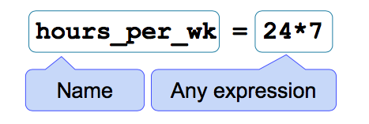
Python Basics - Variables
Variables are reserved memory locations to store some value.
Variables are assigned through assignment statements.
A variable is bound to a value
Notes:
Pooja

Slide 6
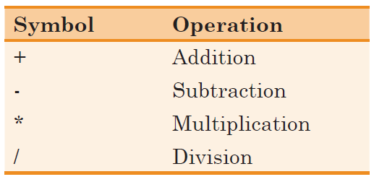
Python Basics - Variables (Operations)
Notes:
Talk about print(variable)
Pooja

Slide 7
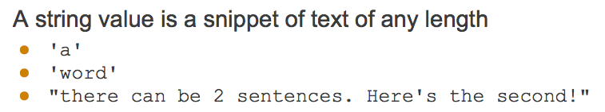

Strings
Notes:
Pooja
What a string is
What you can do with a string
Ex. str = “hello”
Str * 2 = “hellohello”
Add strings
Check if a letter in the string
Ex. h in str - TRUE
Select characters of a string
String methods (uppercase, lowercase, count, replace, remove whitespace)

Slide 8
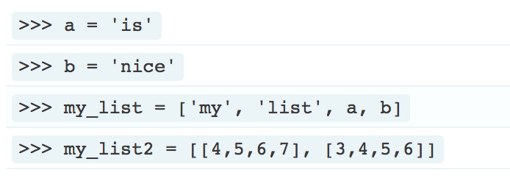
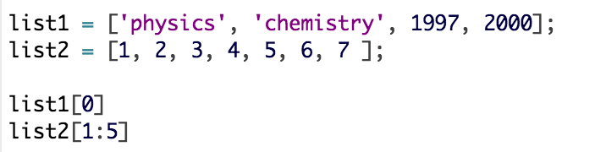
Lists
A list is a collection of objects in a given sequence (can hold numbers, strings, any type of object separated by a comma)
Enclosed in square brackets
Each item in a list is called an element - it is possible to select/get each element of the list (first element of a list has index 0)
Notes:
Shalini

Slide 9
List Operations
Add lists together (so they become one list)
Get the length of a list
Get the index of an element in the list
Add an item
Remove an item
And much more!
Notes:
Shalini

Slide 10
Loops
Loops are used when you want to repeat something multiple times
Two types of loops that will be useful: While loops and For loops
Notes:
Shalini

Slide 11
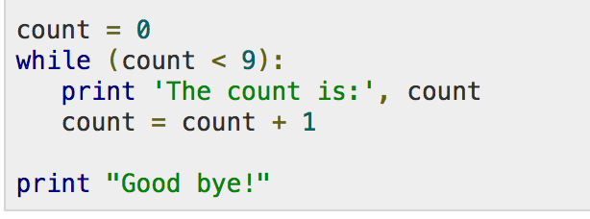
While Loops
Do a certain statement while a given condition is true
When the condition is true, the code inside the loop will be run
When the condition is false, the program goes to the line following the loop
Notes:
Shalini

Slide 12
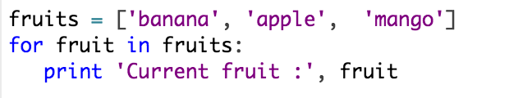
For Loops
Can go through (iterate) over the items of a sequence
List, array, string
Notes:
Shalini

Slide 13
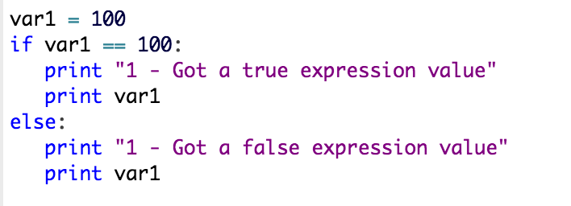
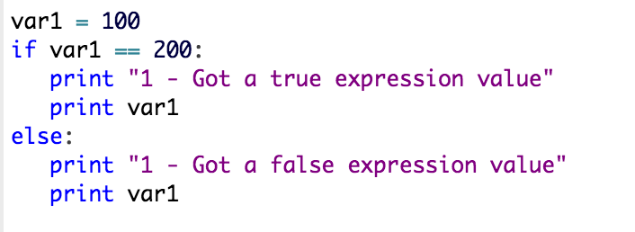
Conditionals
Making decisions
Use if/else if/else statements in order to decide if something is TRUE or FALSE and then execute a statement based on this decision
Notes:
Pooja

Slide 14
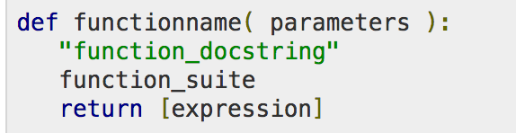
Functions
Block of code that is organized and reusable, and is used to perform a single related action
Python gives some functions for us to use (we’ve seen print() in previous examples)
Making our own function is called a user-defined function
Defining a Function
Notes:
Pooja

Slide 15
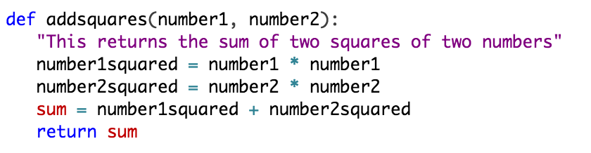
Notes:
Pooja

Slide 16

NumPy
NumPy is a package in Python that allows us to do many things, including making arrays and matrices!
How to import NumPy into a document (this is already done in the exercises document!):
Notes:
Shalini

Slide 17






NumPy Operations
Select numpy array elements
Insert items into array
Delete items into array
Mean of array
Median of array
Standard Deviation of array
Notes:
Shalini

Slide 18
Importing a datascience library (to make tables and arrays)
$ pip install datascience
//where you want to install the data science file - can be in Desktop or elsewhere
Notes:
Pooja/Shalini

Slide 19
Tables
Make a table
Add columns
Add rows
Sort
Select a column and make an array out of it
Filter
Notes:
Pooja

Slide 20
Exercises
Navigate to the Python_workshop_Sep2017.ipynb file and open it
There will be a bunch of exercises for you to try out and implement the concepts that we have covered!
Questions about anything? Call one of us over!

Slide 21
Feedback!
Fill out this form:
goo.gl/7BJKkW

Slide 22
Sources
www.data8.org
http://www.practicepython.org

